Slide 1
Lecture 12: Further topics in Information Theory
Part 1: Continuation of Shannon’s paper
Part 2: Determining authorship of The Federalist by Mosteller and Wallace

Slide 2
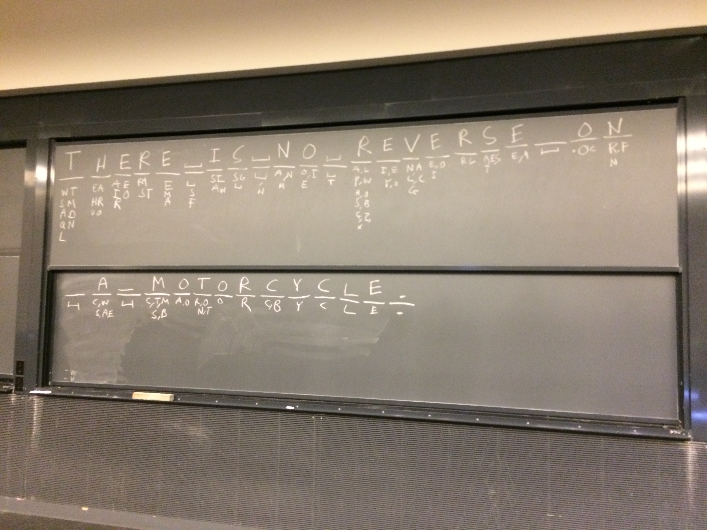
Notes:
Each letter of a mystery text message was revealed one-by-one. Before each letter was revealed, plausible guesses were listed. The number of plausible guesses varies dramatically. The most information about the message is revealed when there were many guesses.

Slide 3
Information content
Numbers in 0 to 63, such as 47=101111, need six bits of information
If the numbers are equally probable, then being told the number has information content
Each binary digit has one bit of information content
Adapted from Information Theory by Iain Murray, http://www.inf.ed.ac.uk/teaching/courses/it/

Slide 4
Guess a number from 0 to 63
Is the number 36? a1=No
Is the number 42? a2=No
Is the number 47? a3=Yes
Total information: 0.0227+0.0231+5.9532 = 6 bits
Adapted from Information Theory by Iain Murray, http://www.inf.ed.ac.uk/teaching/courses/it/

Slide 5
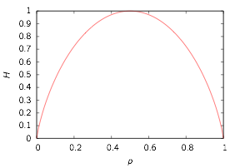
Shannon entropy
Source has syllables with probabilities p1, p2, …, pn
Shannon entropy: average information content of a source
Example: unfair coin p1 = p, p2 = 1–p
Makes sense:
H=0 if p=0 or p=1 as we gain no information
H is maximum if p=0.5 as it’s the most uncertain case

Slide 6
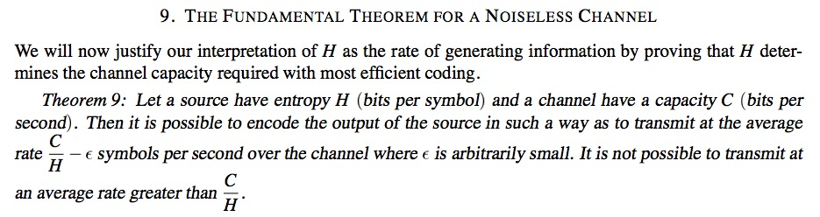
Shannon’s fundamental theorem
Suppose the information source has entropy H and the channel has capacity C
One can encode the output of the source to that it can be transmitted a rate of up to C/H symbols per second
It is not possible to transmit faster than C/H

Slide 7
Python examples

Slide 8
Dictionary example
Input program
Output
# List recap
a=[1,2,6,4]
print a[1]
# Modify the list and print it
a[3]=10
print a
print
# Initialize a dictionary
b={'alice':67,'bob':32}
print b['alice']
# Add another dictionary element
b['charlie']=12
print b
# Print the keys of the dictionary
print b.keys()
print
# Loop using keys and values
for c,d in b.iteritems():
print c,d
2
[1, 2, 6, 10]
67
{'charlie': 12, 'bob': 32, 'alice': 67}
['charlie', 'bob', 'alice']
charlie 12
bob 32
alice 67
Notes:
In a list, the entries are indexed by integers starting from zero. A dictionary is a more general data structure, where its entries can be indexed by any string. This a very similar to the organization of a physical dictionary.
Example: dict.py

Slide 9
Counting frequencies
Input program
Output
# String of text
a='She sells sea shells on the sea shore'
# Split elements into a list
b=a.split(' ')
# Count the words
c={}
for w in b:
if(w in c):
# Add 1 to existing counter
c[w]+=1
else:
# New counter
c[w]=1
# Print frequencies
for w,f in c.iteritems():
print w,f
on 1
shells 1
shore 1
She 1
sea 2
sells 1
the 1
Notes:
Dictionaries are very useful for counting frequencies of words in text. Here, a string of text is broken into words, and then the frequencies of each word is counted in a dictionary. Note that “She”, “she”, or “she!” would all be stored as different keys—Python does not make any attempt to recognize these as the same word.
Example: d_count.py

Slide 10
Regular expression example
Input program
Output
# Import regular expression functions
import re
# Create test list
a=["cat","dog","bear","bird"]
# Create pattern to match "a" character
p=re.compile("a")
# Print elements in list that match
for x in a:
if(p.search(x)):
print x
# Create pattern to match "b" or "d"
p2=re.compile("[bd]")
# Print elements in list that match
print
for x in a:
if(p2.search(x)):
print x
cat
bear
dog
bear
bird
Notes:
Regular expressions are a general and very flexible way to process and transform strings of text. While the details may differ slightly, regular expressions are found in many programming languages and tools, and are not unique to Python. In the first example here, elements in a list with an “a” are found. In the second example, elements with either a “b” or “d” are found.
Example: reg_exp.py

Slide 11
Regular expression example
Input program
Output
# Import regular expression functions
import re
# Pattern to match color names
p=re.compile("(green|red|blue)")
# Test string
s="The primary colors are red, green, and blue."
# Change all matches
print p.sub("color",s)
# Only change the first match
print p.sub("color",s,count=1)
# Second test string
t="You can't touch this!"
# Pattern to remove punctuation
p2=re.compile("[!,'\.]")
# Apply it
print p2.sub("",t).lower()
The primary colors are color, color, and color.
The primary colors are color, green, and blue.
you cant touch this
Notes:
Regular expressions can be used to substitute some text in a string for something else. The can either apply to multiple times to the string (as in the first output line) or just to the first occurrence (as in the second output line). In the context of word analysis, regular expressions can be used to strip out punctuation. The string command “lower()” can also be used, to convert a string to lower case.
Example: reg_exp2.py

Slide 12
The Federalist
85 articles published in New York advocating the ratification of the US constitution during 1787–1788
Used in many court cases as a way to interpret the Founding Fathers’ intentions about the constitution
Authorship was a closely guarded secret (written under the pseudonym Publius)

Slide 13
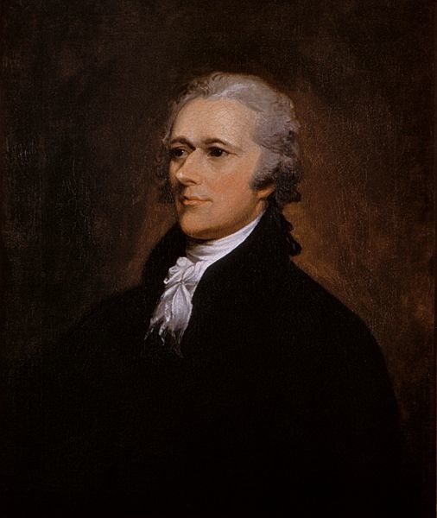
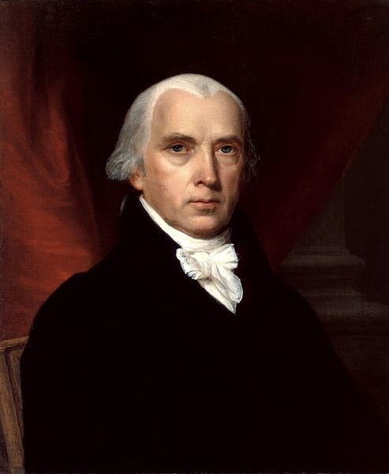
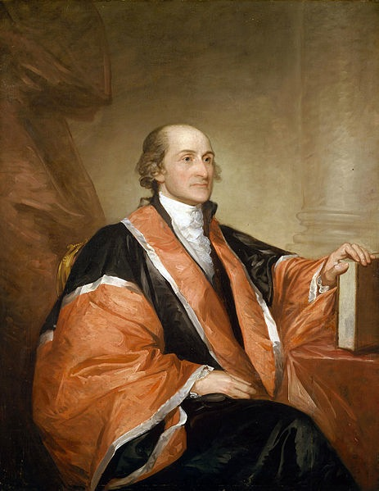
Suspected authors
Alexander Hamilton
(1757–1804)
James Madison
(1751–1836)
John Jay
(1745–1829)

Slide 14
Disputed authorship
Soon before his fatal gun duel, Hamilton provided a list claiming authorship of 63 of the articles (with three jointly written with Madison)
Later, Madison claimed 29 for himself, suggesting that the difference was “owing doubtless to the hurry in which [Hamilton’s] memorandum was made out”
Hamilton’s list contained at least one known error, attributing No. 54 to Jay, when in fact Jay wrote No. 64
How can the authorship of the articles be determined?

Slide 15
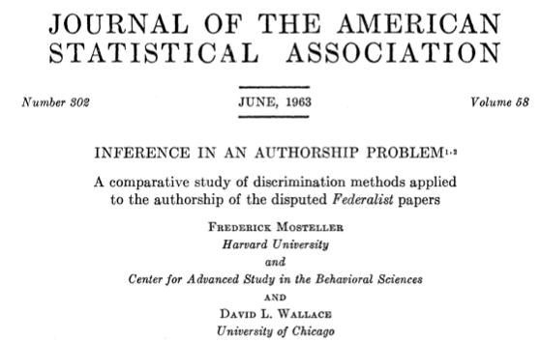
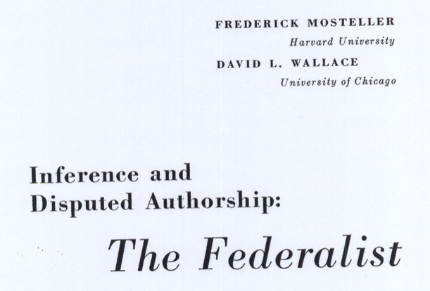
An information theory approach
by Frederick Mosteller and David L. Wallace

Slide 16
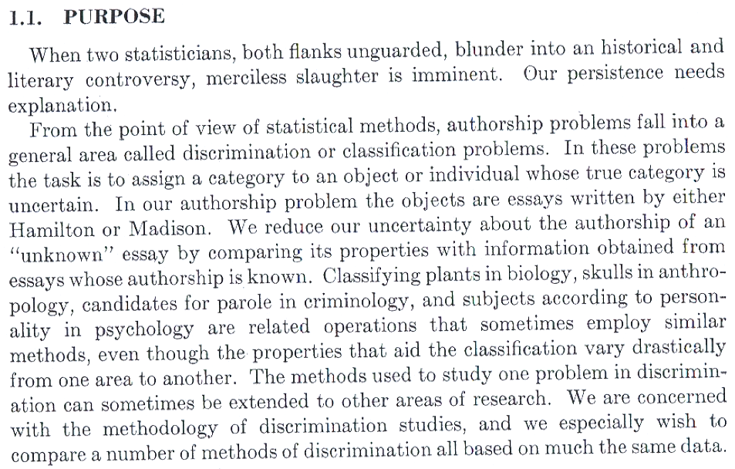
Notes:
Paper is quite humorous.
compare unknown texts to known
use several methods of “discrimination”

Slide 17
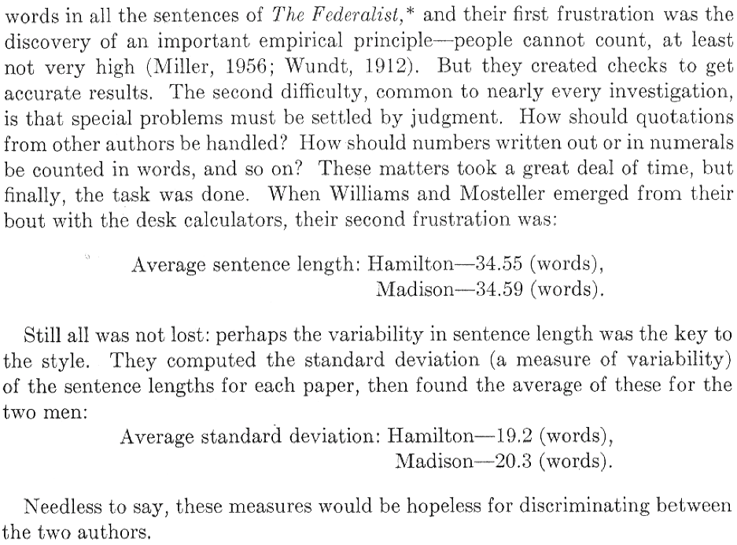
Approach #1: Sentence word count

Slide 18
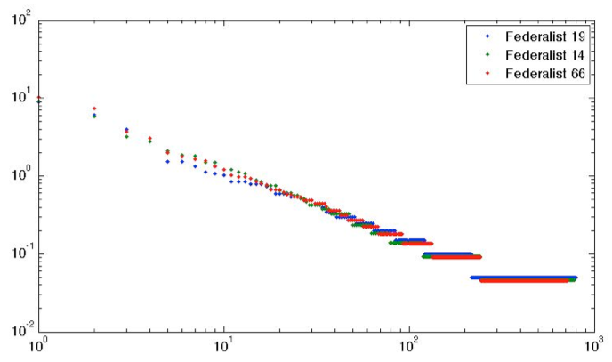
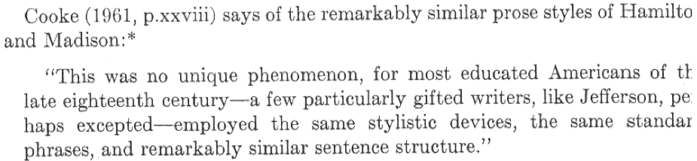
Approach #2: Zipf’s law
66 by Hamilton
14, 19* by Madison
Frequency
Word
Notes:
19 was considered jointly written in paper

Slide 19
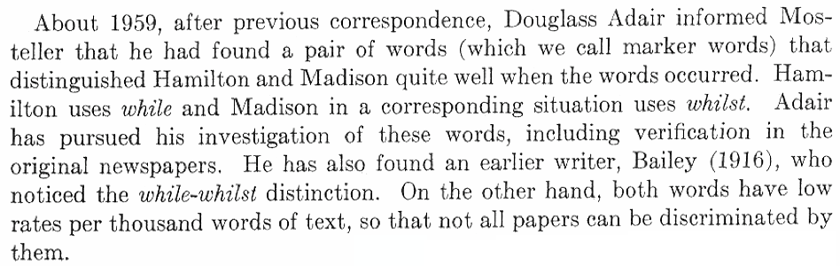
Approach #3: look for special words
Experts in the field had considered this, but did not see how to use this to determine authorship with certainty
But Mosteller and Wallace pursued it in the hope that with enough markers the evidence would become overwhelming

Slide 20
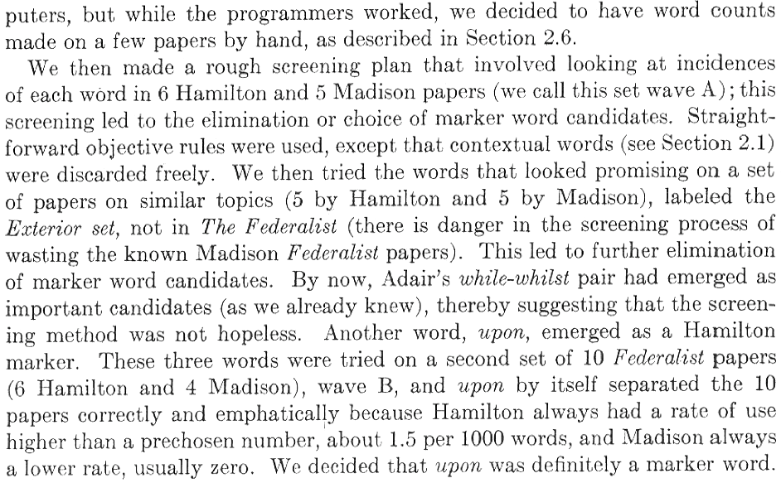
Mosteller and Wallace’s approach
Notes:
How do you choose “marker words”?
—> Screening through texts of known authorship

Slide 21
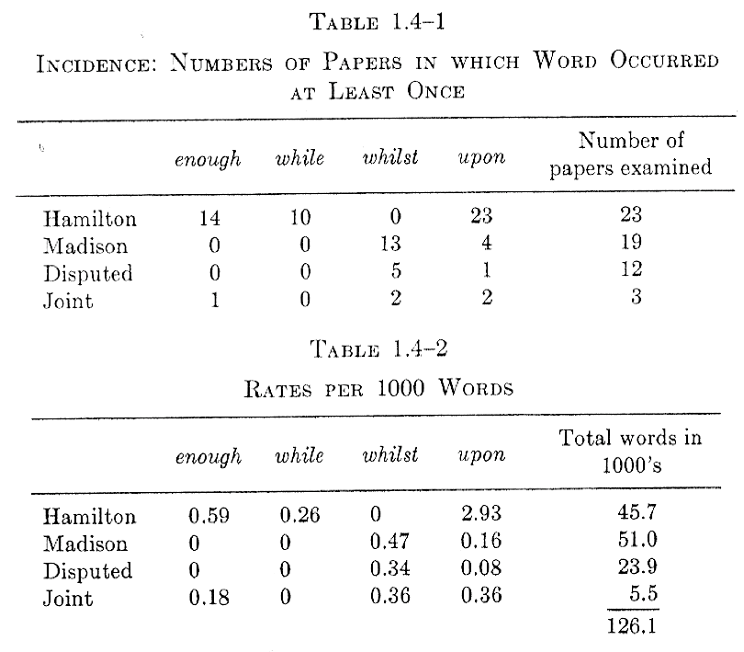
Tabulated data

Slide 22
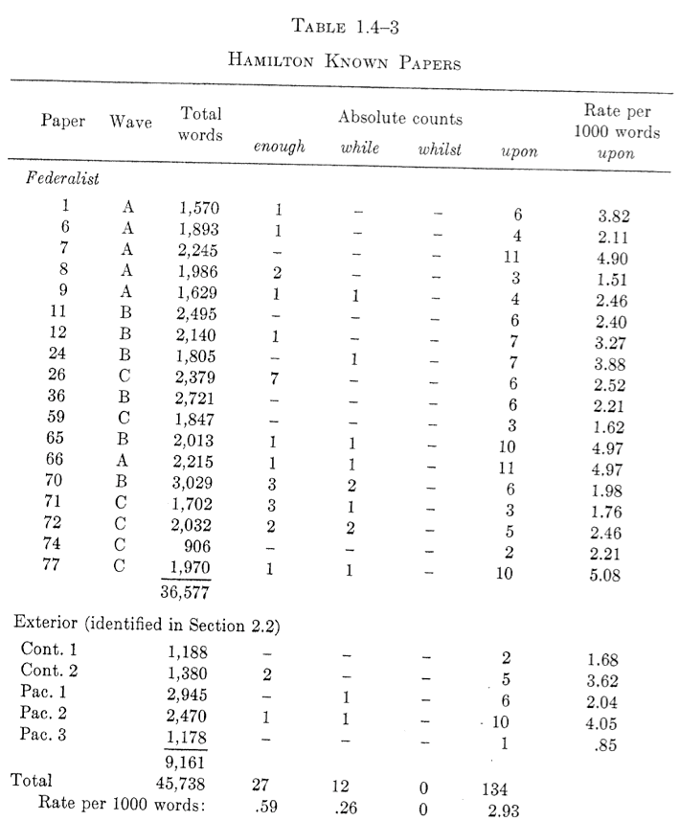
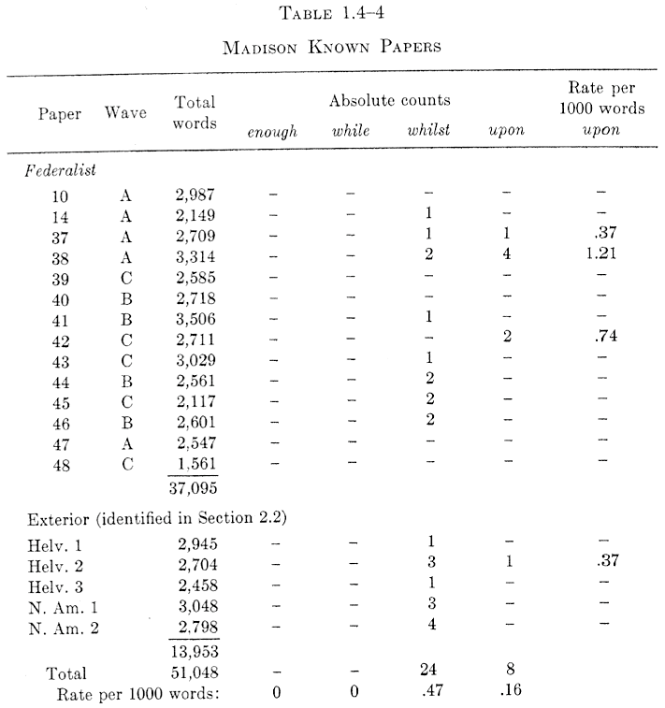
Systematic study
Hamilton
Madison

Slide 23
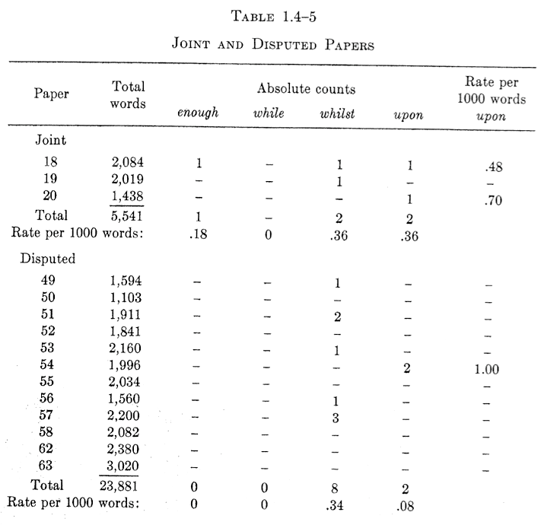
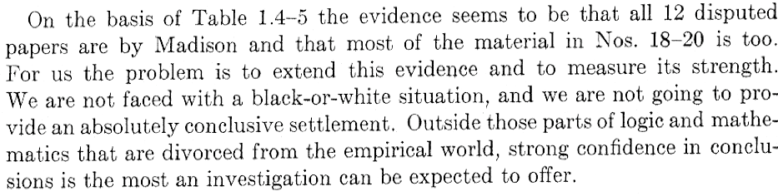

Slide 24
Getting more specific
How can we ascribe an actual probability that a given paper is written by Hamilton and Madison?
A random variable X follows a Poisson distribution if
A good model: the total number of occurrences of a particular word in a given paper follows a Poisson distribution
Notes:
Poisson probability is good for rare events

Slide 25
Bayes’ Theorem
Let F be the event that the TV weather forecast says it will rain, and let R be the event that it actually rains
The probability of
Similarly, and hence
Joint probability of both events
Probability of F happening given that R happened
Posterior – my estimate of rain, given the rainy forecast
Prior – my initial estimate of rain

Slide 26
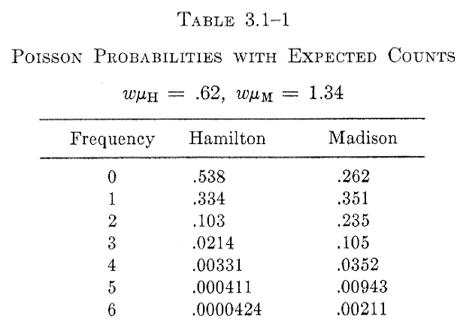

Example: “also”
Expected number of occurrences
w = word count in 1000s
𝜇 = rate per 1000 words
Let H be the event that Hamilton wrote the paper, and let M be the event that Madison wrote the paper
Suppose that “also” is used 4 times a paper. What are the odds that Hamilton wrote the paper?
𝜇H = 0.31
𝜇M = 0.67

Slide 27
Two interpretations
Ratio of probabilities (“likelihood ratio”)
Hence you might say that the odds are 10:1 that Madison wrote the paper.
But this depends on what your prior belief about who wrote the papers is.
If you had other reasons to think Hamilton wrote the paper, you might feel differently.

Slide 28
The use of Bayes’ Theorem
From Bayes’ Theorem
Hence
Prior odds of Hamilton versus Madison
Posterior odds of Hamilton versus Madison
Probabilities estimated from Poisson model and observed data

Slide 29
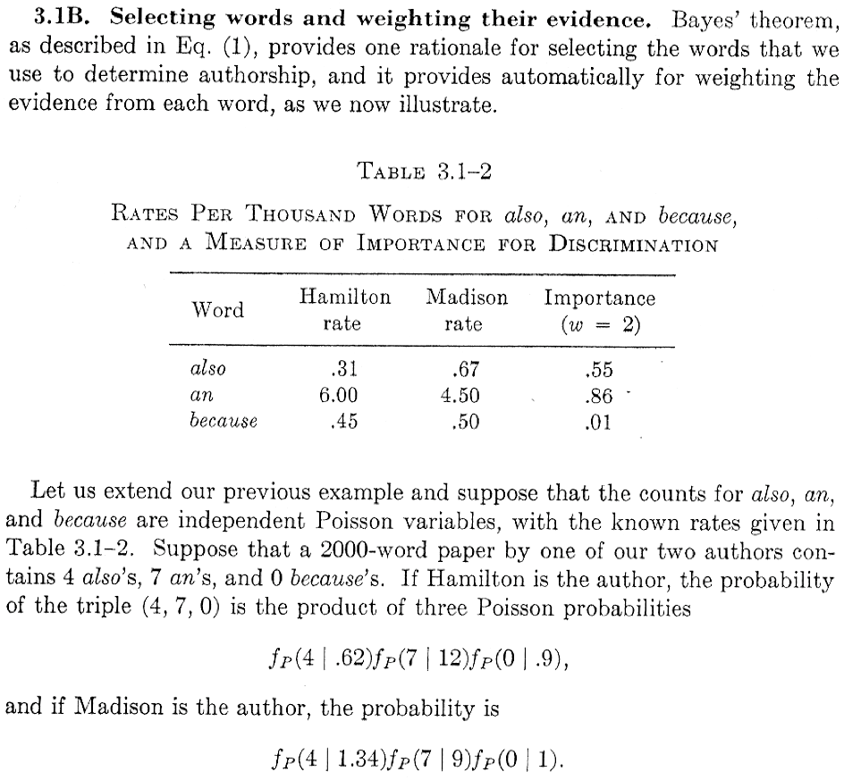
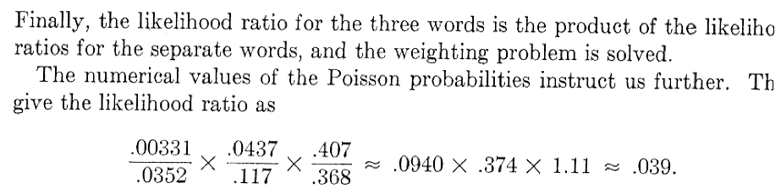

Notes:
Likelihood ratio for 3 words

Slide 30
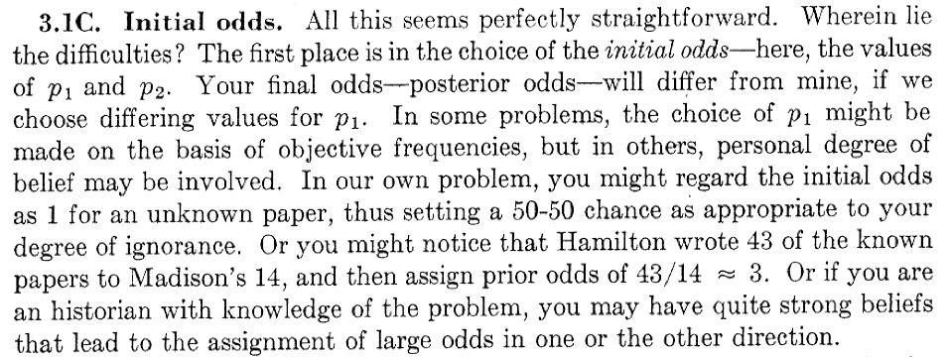
Subtleties
Notes:
Problem: choosing your priors

Slide 31
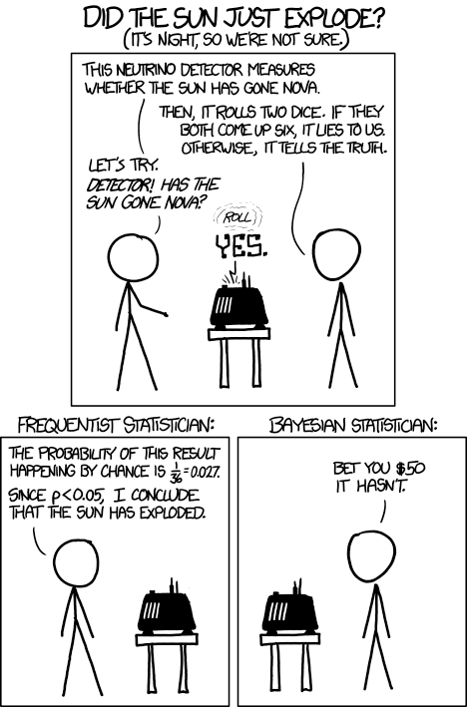
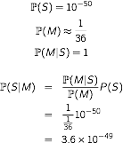
http://xkcd.com/1132/

